Slide 1
Sharing the importance of clean water and rainwater harvesting to communities of students in NYC and India
Faculty Mentor: Dr. Indrani Pal
Industry Mentor: Dr. Hari Haran
Graduate Mentor: Carolina Perez
Notes:
Sharing the importance of clean water to communities of students in NYC and India
Two questions:
Is it feasible to install rainwater harvesting as a solution to climate adaptation in new york
We aim to explore that question with implementation experts from bangalore
Students will learn about climate from these cities have been changing and does the water cycle. Climate is geeting wetter, flash flooding is increasing
Although ny is a coastal city we can look at innovative ideas, decrease flash flooding events
Find water statistics of water bill, on average how much do we pay for water, water usage and
How: Awareness building
Buildings to install rainwater harvesting practices
Look at historic and hydro met net data to demonstrate rainfall features. We will learn about how feasibility can change based on culture and climatic behavuir and infrastructure in Bangalore
Collaboration: Talk about Dr. Hari

Slide 2
50%
How much do we know about Water?
Of India’s population has access to safe drinking water
Notes:
Add sources to the slide

Slide 3
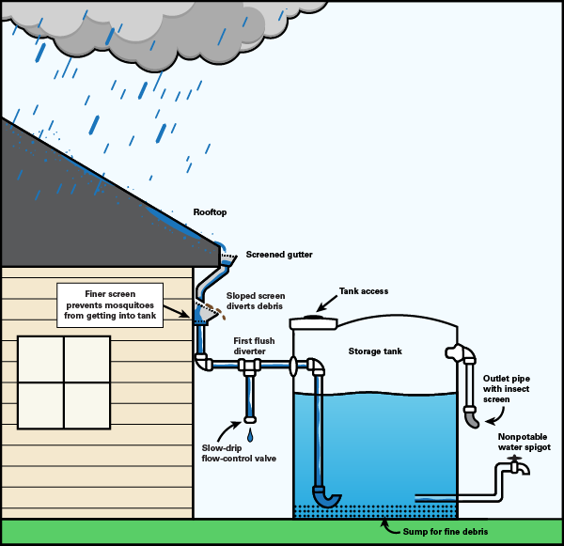
One known potential solution is Rainwater Harvest
Rainwater harvesting collects the water during a rainstorm, it is beneficial to communities through:
Reducing Demand of Water Supply
Reduces Water run off, hence flash flooding in urban areas
Reduces Erosion
Reduces Contamination of Surface Water

Slide 4
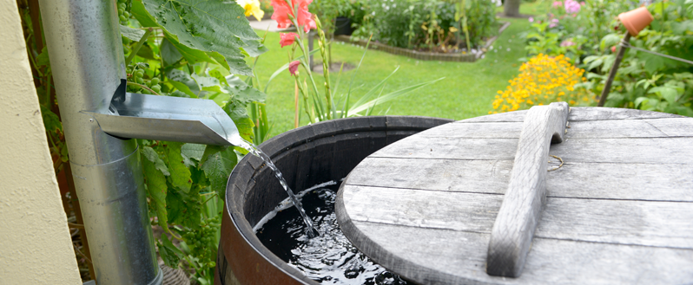
One known potential solution is Rainwater Harvest
In India, approximately 24 million hectare meter equivalent runoff is available for harvesting!
Shwetha, K.S., K.V. Ashalatha, A.R.S. Bhat and Tanveer Ahmed Khan. 2019. A Statistical Study on the Impact of Rain Water Harvesting on Groundwater Levels and Farming Economy.Int.J.Curr.Microbiol.App.Sci. 8(4): 906-912.
Notes:
Add source

Slide 5
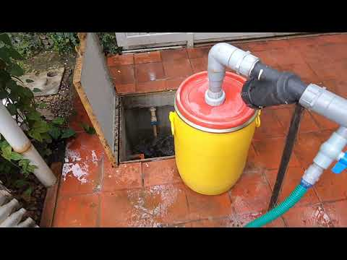
Neel Matthew @ Sycamore
He Pays $0 for Water and Electricity
What can we learn from those who collect rainwater and apply them here in NYC? Is that even possible?
Notes:
Add source

Slide 6
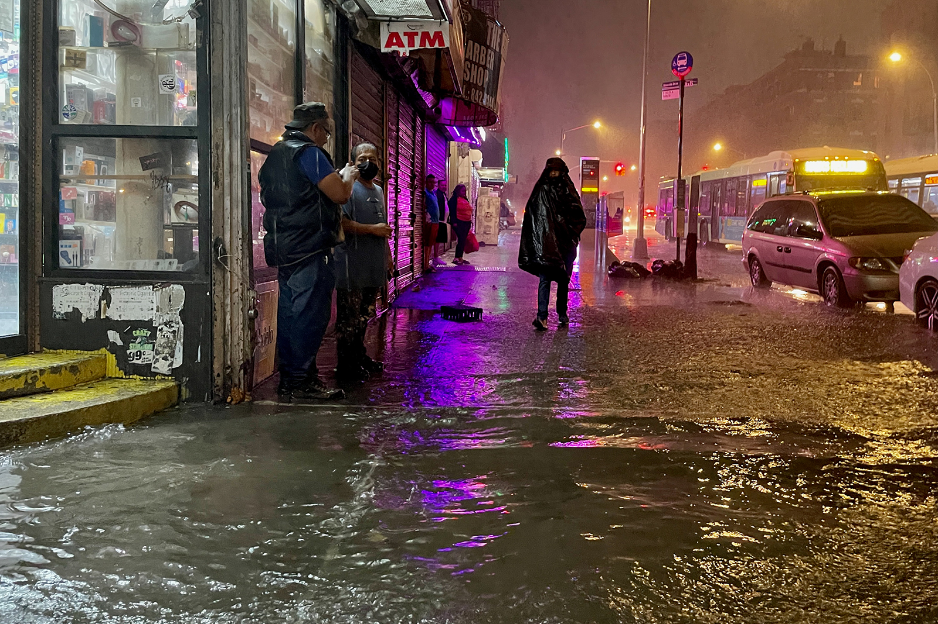
Is it feasible to install rainwater harvesting as a solution to sustainable living in the face of Climate Change in New York, U.S. and in Bangalore, India?

Slide 7
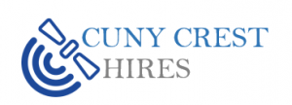
Creating a Campaign for Students in NYC & India focused on Rainwater Harvest and Clean Water
Student Interns Will:
Conduct Interviews and speak to community leads and climate/water researchers from Bangalore and learn about why and how RWH is contributing to sustainable livelihoods
Educate and track STEM Hive program students on the equipment and measure water quality in NYC
Create and Host Awareness Workshops
Learn how to use Water Testing kits on NYC rainwater and teach procedures to students

Slide 8
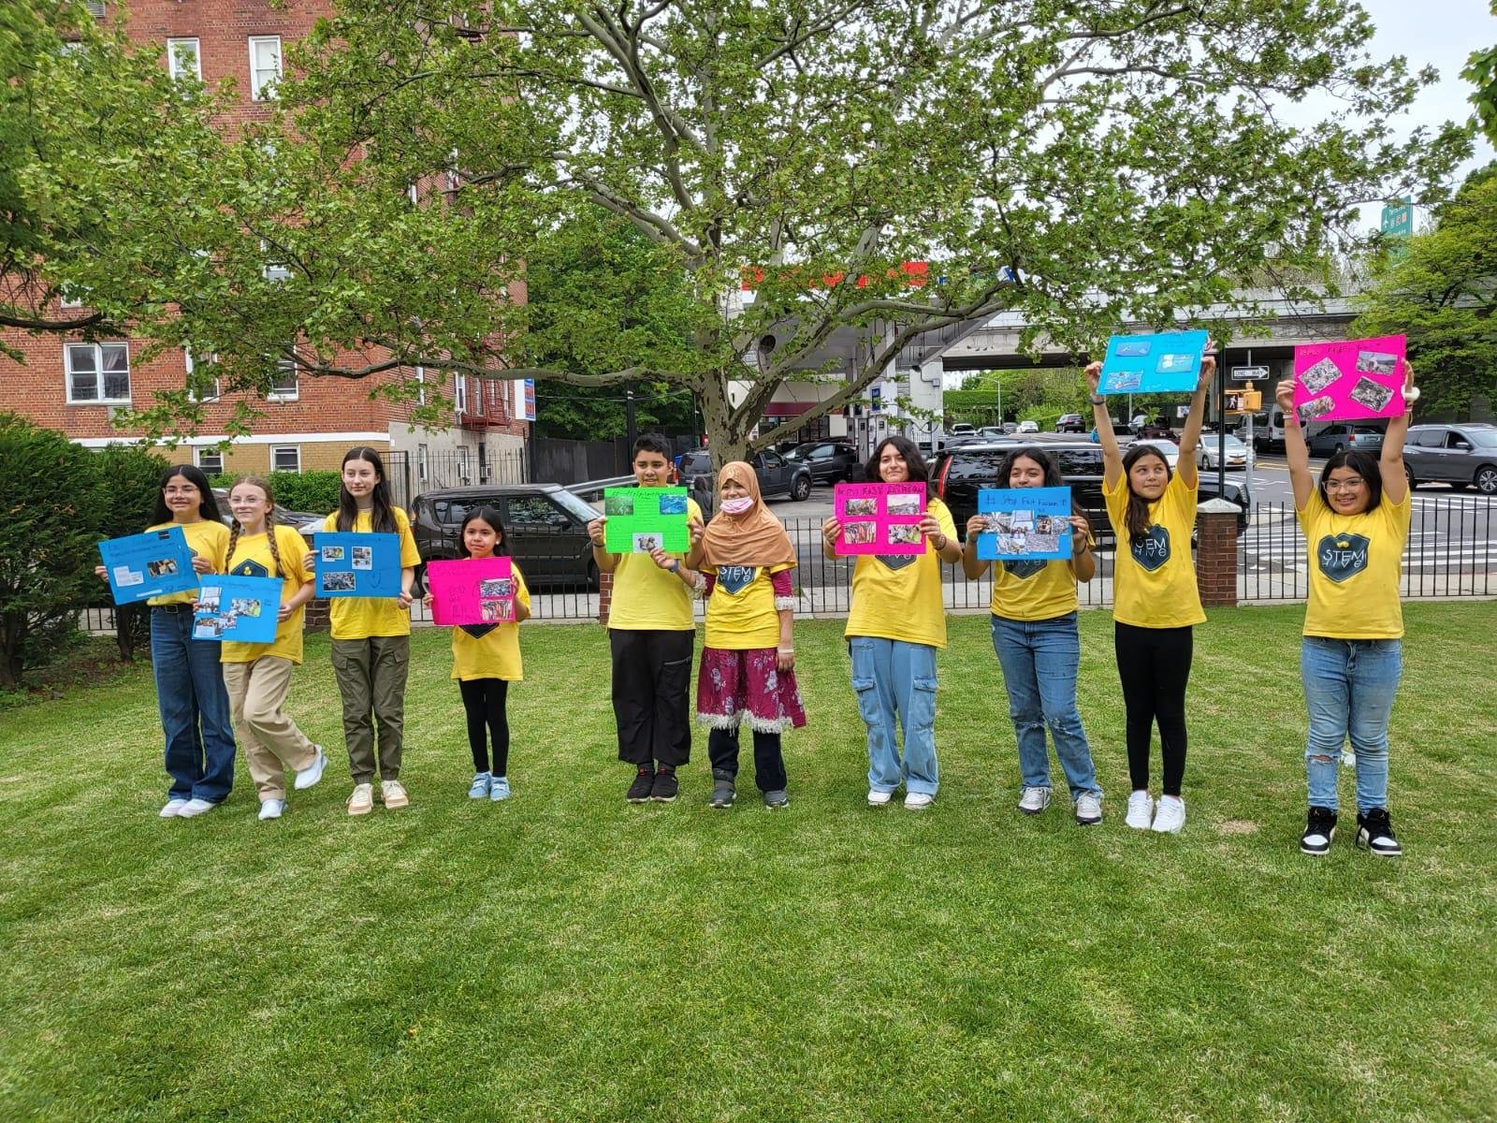
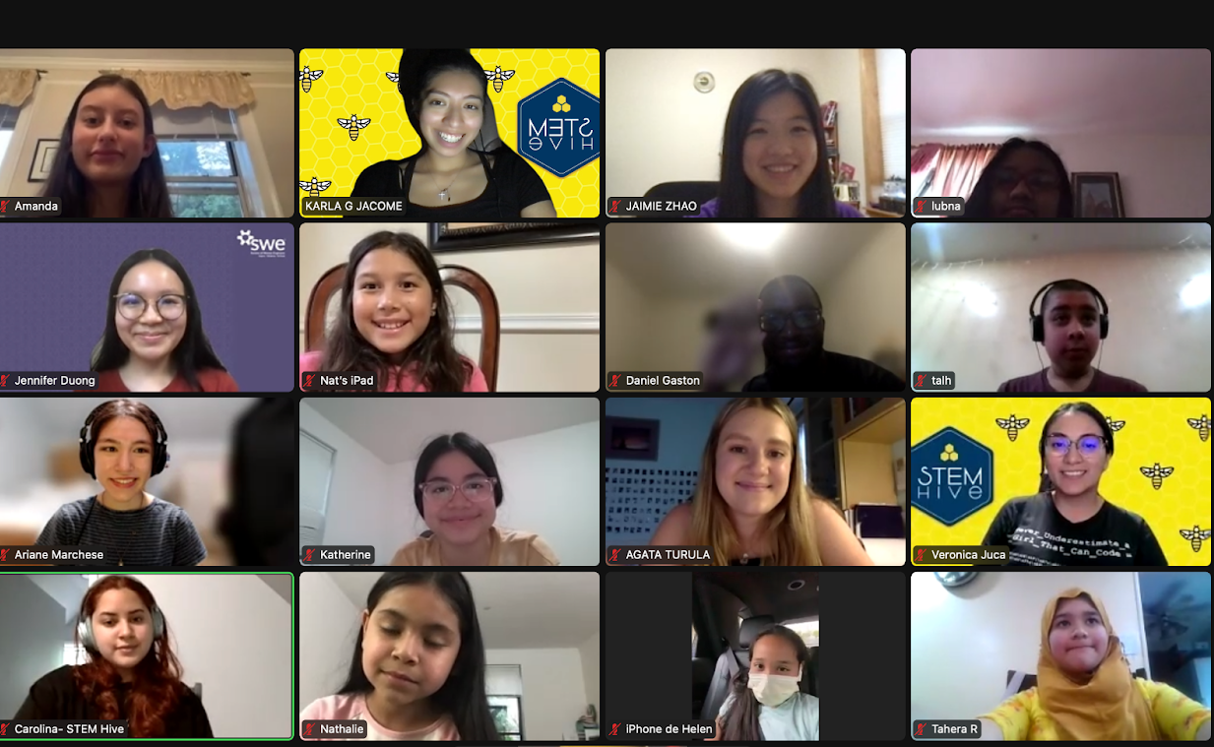
Partner Organizations
STEM Hive is an official 501(c)3 Nonprofit organization in NYC that provides educational opportunities and career awareness of disciplines in STEM by supporting the participation of children of underrepresented groups at the elementary and middle school levels.

Slide 9
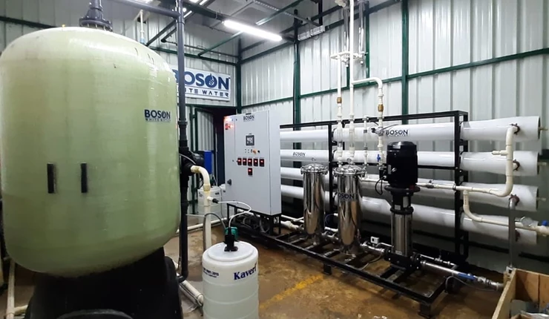
Partner Organizations
AltTech foundation is not-for-profit organization that has been working on energy and water solutions for over the past decade.
3 main areas of focus:
(a) professional education, with SAANSS (Sustainability Arts And Science)and industry leaders sharing experiences.
(b) public campaigns to involve/engage, with the WOW (World of Water) Action Forum that has set an audacious target of ten billion litres of water saved with the help of many city leaders joining this initiative.
(c) practical research to help policy and governance, with Programmes.

Slide 10
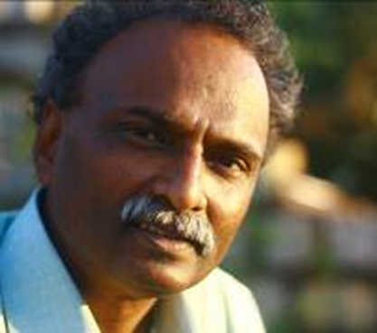
Meet Industry Mentor: Dr. Hari Haran
CEO, Founder of Alttech Foundation
Ecological Economist from India
Focused on Water and Energy Sustainability
Leader of WOW AF (World of Water Action Forum)

Slide 11
Research Outcomes
A Rainwater harvest educational model will be created and presented to students in NYC (through STEM Hive) by gathering information, creating social campaigns, and spreading awareness of the importance of clean water through hands-on training workshops.
The educational model created in Bangalore, India will serve as the basis for educating students in NYC.
Creating an article/blog on a popular sustainability outlet

Slide 12
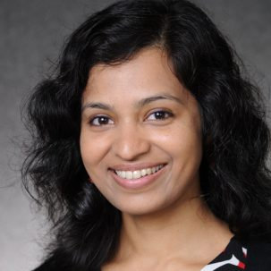
Our team
Indrani Pal, PhD
Carolina Perez
Hari Haran, PhD
Water Scientist and Researcher CUNY CREST Institute
CEO, Alttech Foundation Economic Ecologist
Graduate Mentor
HIRES Program Coordinator

Slide 13
Thank you and we look forward to working with you!
Notes:
Sharing the importance of clean water to communities of students in NYC and India
Water:
Research on water in bangalore
Having discussion with Dr. Hari
INterviewing
Speak to facility from bangalore and learn about their water research
Creating awareness about water
You ask question, including interactive meetings
Finding the right time to do this:
NITTE School of Design
4 members on the council
Involving students in planning
Visual
Architecture
Workshop Planning
Course Study
Regional
Pick 3 people from taskforce
How to demonstrate
Environmental learning: Hands on work
Learning Beyond the classroom
Rain gauage- order water test kits (nitrates)
Sustainable
70% of any cities of water needs can be met out of rainwater
Easily Deployable
Viable
Research:
What people are doing with rain water?
People doing rainwater harvesting from home
Zero water bill
Water adaptation to climate change:
Bangalore weather climate
Flash flooding
Explore the potential of rooftop rainwater harvesting (NYC) how is it beneficial?
Skills the student would learn:
Benefits:
Use the water for any purpose
Reducing flash flooding in Bangalore
Our student go to demonstrate how to
HS & Master: Educate and track STEM Hive program students on the equipment and measure water quality in NYC
Bangalore: Engineering students in contact with SB and HIRES they educate the younger students from Bangalore (partner schools)
Make that case:
Details of what the HIRES student will do:
Details of what the Summer Bridge Student will do:
Documentation
Research
Expectations of Student:
Head of that process Carolina:
Create DIY book, process model so that it could be replicated
Clear and simple so that it could be translated to other countries
Create curriculum for the students
Mentoring the HIRES
Demographics:
India 10-15 years of age 5 year to 10 year (grade)
NYC 7-13 years of age
Creating a flowchart of a time when we expect will be done
Policies of
Ngo bc basrf create water utilities leer
Sustainable Innovation
Agerawal ccn hero indrani is board of director expanded from 7 to 30 villages in india
By end of august: completed one school of 800 kids in this age group
How to communicate?
SMS?
How to make it accessible
150 smart cities in India - see if we bring efficiency in water energy
Teaching the importance of rainwater harvest and quality
Sensor meter?
Use video clips in our presentation:

